Slide 1
Seminar and Technical Communication
Athang Gupte
Roll no - 31206
Class - TE-2
Under the Guidance of
Prof. Ashwini A. Jewalikar

Slide 2
Comparison Of Bayesian Filtering Algorithms For
RSSI

Slide 3
Abstract and Motivation
Abstract
Increasing demand for Indoor Positioning has motivated researchers to explore more efficient and accurate methods. Most contemporary real-time solutions involve measuring RSSI and converting the measurement into distance. Yet RSSI values are not reliable due to high fluctuations caused by environmental factors and multiple reflections. This study intends to compare between two most commonly used filters for RSSI localization problems, Kalman Filter and Particle Filter, in terms of accuracy, power consumption and efficiency.
Motivation
Despite the advantages of using RSSI, accurate measurement of RSSI for actual use in real-time Indoor Positioning Systems faces many problems because the effect of the environment and the devices themselves is very high on the signal.
Multipath Effect
Shadow Fading Effect
Interference
Environmental Effects
Notes:
1. Multipath Effect - In indoor environments the signal received by the receiver contains not only the waves following direct Line of Sight (LoS), but also a large number of signals that have reflected from walls and other obstacles [2]. These reflected radio waves are delayed and have greater attenuation than the actual LoS signal and thus the RSSI values of these signals are incorrect and add to the noise of the signal.
2. Shadow Fading Effect - The presence of obstacles in the LoS of the transmitter and the receiver causes attenuation of the signal and thus the received RSSI is lower than that of actual LoS. According to [3], the wireless signal strength has shadow fading effect of the log-normal distribution (i.e. the logarithm of the shadowing function is normally distributed).
3. Interference - Indoor environments can have a lot of radio trac including WiFi signals, Bluetooth radios, cellular transmissions, and a lot of other magnetic interfering sources. These signals especially WiFi and Bluetooth cause interference in the Bluetooth Low Energy (BLE) radio waves and add to the noise of the received signal strength.
4. Environmental Effects - Big magnetic metallic objects, like iron in the RCC structure of buildings, may distort the magnetic eld and thus introduce noise in the nearby signals.

Slide 4
Literature Survey
There have been many approaches toward filtering of RSSI to make it usable in finding distance. Some approaches are based on simple arithmetic estimations, such as -
Simple Moving Average, Exponential Moving Average
Moving Median, Moving Mode methods
Alpha Trimmed Mean
Adaptive-Bounds Band-Pass Moving-Average filter
Weighted Average filter
Most researches have been focussed on stochastic and probabilistic approach such as Bayesian Filtering methods -
Kalman Filter, Extended Kalman Filter
Unscented Kalman Filter
Particle Filter
Gaussian Filter

Slide 5
Survey on Papers
[Mackey, 2018] - A simple static Kalman Filter (KF) was implemented and their results show that the Kalman Filter provides impressive improvements to system performance. The overall error was improved by up to 79% by applying the filter. Their observations depict the effect of the size and locality of the geo-fence in the resulting accuracy. Another notable observation is that as the distance between the anchor nodes, i.e. the beacons, increases the system is less affected by noise. Thus their system was suggested for larger indoor environments.
[Khan, 2015] - The paper compares Kalman Filter (KF), Extended Kalman Filter (EKF) and the Particle Filter (PF) in the context of a constant velocity motion model. The tracking is done in a 2-Dimensional model where the RSSI from one target node moving with a constant speed and sudden changes in its direction is observed. The results show that EKF exhibits superior performance than KF and the PF, despite being computationally expensive, outperforms EKF and KF by a big margin, especially a when large number of particles are used. For a smaller number of particles EKF may show better performance than PF.

Slide 6
Survey on Papers
[Pelka, 2016] - Another in-depth comparison has been presented in this paper, between Kalman Filter (KF), Extended Kalman Filter (EKF), Unscented Kalman Filter (UKF) and Particle Filter (PF) using Ultra Wide Band (UWB) positioning system. They inferred that the performance of the filters depends on the system model as well as the actual implementation. The experimental results show that UKF delivered the best performance among all the filters. They found that the PF always performed below par with the Kalman filters. PF can always be applied regardless of linearity or non-linearity of the model, but its exceedingly high runtimes make it less applicable in real-time systems.
[Svecko, 2015] - They demonstrated use of multiple antennas on the receiver, combining the readings and filtering using the PF to improve noise reduction and accuracy. They used different combinations of particle filter, ground-reflection model, log-normal model using different antenna-arrangements. Their results showed that the accuracy was better when using the proposed particle filter along with the ground-reflection model. They also inferred from the experiments that the selection of different resampling methods is not critical for the accuracy of the given algorithm.

Slide 7
Survey on Papers
[Nowak, 2018] - The authors apply adaptive Kalman filters to simultaneously estimate the position and channel parameters in Wireless Sensor Networks (WSNs). They use the Unscented Kalman Filter (UKF) along with a time-variant noise process tracked by a Variational Bayesian approximation. The resultant algorithm, the Variational Bayesian Adaptive Unscented Kalman Filter (VBAUKF), does not suffer from performance degradation and the noise estimates match with the channel model. Adaptive filtering enables for optimal tracking performance in scenarios where the target objects traverse regions with different propagation characteristics.
[Zhang, 2016] - A novel method is introduced, which takes advantage of two filters - Gaussian Fitting Filter and Kalman Filter. Their analysis posits that the wide fluctuations in the RSSI cannot be completely eliminated by either Gaussian lter or Kalman filter alone. Thus they put forward the Gaussian-Kalman filtering algorithm. They first use the Gaussian Fitting filter with a large number of RSSI values. The estimate and standard deviation are used in the KF and finally linear regression is conducted on the output. Their algorithm was able to surpass both the Gaussian and Kalman filters in accuracy and noise elimination.

Slide 8
Survey on Papers
[Zafari, 2017] - A cascaded algorithm combining KF and PF was presented in this paper. The accuracy of localization is improved by 28.16% in 2D and 25.59% in 3D environmental contexts when compared to using only a PF. KF was used to smooth the signal and the smoothed RSSI values were used as input to PF for non-linear tracking.
[Zafari, 2017] - In this paper another novel technique is proposed by the authors of the previous paper. They present a cascaded algorithm that combines PF and EKF in series to reduce the impact of multipath effects and noise on the RSSI. When compared with a lone PF, their Particle Filter - Extended Kalman Filter (PF-EKF) algorithm improved localization accuracy by 31.3% and 33.9% in 3D and 2D environments respectively. They also showed that the PF-EKF algorithm outperforms their previous work, the KF-PF cascaded algorithm in [Zafari, 2107].

Slide 9
Implementation

Slide 10
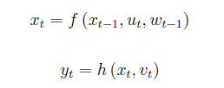
Mathematical Model
State-Space Model:
State-Space model is a mathematical model used to represent a system using state variables and first-order differential equations or difference equations.
They are defined by a set of inputs, outputs and state variables. The state variables depend on inputs and outputs upto the current timestep but are not themselves measured in the experiment.
(1) - Process Model
(2) - Measurement Model
where at time t, x_{t} is the process state, u_{t} is the input, w_{t} is the process noise, y_{t} is the measurement and v_{t} is the measurement noise.
Process Model - generates current state from previous state, current input and process noise.
Measurement Model - obtain current measurement from current state and measurement noise.

Slide 11

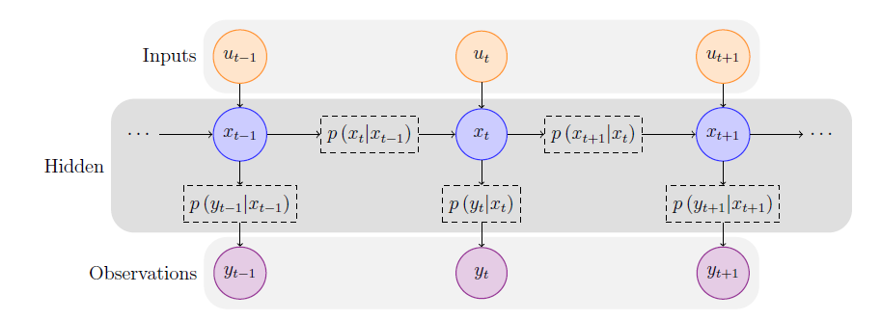

Mathematical Model
Hidden Markov Chain Model (HMCM):
The above model of a temporal dynamic system is assumed to be a first-order Markov Chain.
This means that the current state x_{t} only depends on the last state x_{t-1}, and the current observation y_{t} is determined only by the current state x_{t} and not on the states before that.
The state-space model can be represented as a functional form of the Hidden Markov Chain Model as shown in the figure.
The Markov Chain is hidden as it cannot be altered nor measured directly.
Notes:
It comprises of the initial density p(x₀), transition density p(x_{t}|x_{t-1}), and the likelihood density p(y_{t}|x_{t}).

Slide 12

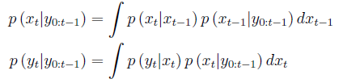
Recursive Bayesian Filtering
The objective of ltering is to estimate the optimal current state at a time t based upon the observations upto time t, which is in fact the posterior probability distribution, i.e. p (x_{t}|y_{0:t}).
By using Bayes’ Theorem and the properties inherited from the HMCM we get -
(3) - Posterior density
(4) - Predict
(5) - Update
This provides a notationally tractable representation of the filtering problem, whose solution is given by the posterior density.
But the problem may remain intractable since the posterior density is a function and not a finite dimensional point.
Notes:
prior density p(x_{t}|y_{0:t-1}), likelihood p(y_{t}|x_{t}) and evidence p (y_{t}|y_{0:t-1})

Slide 13

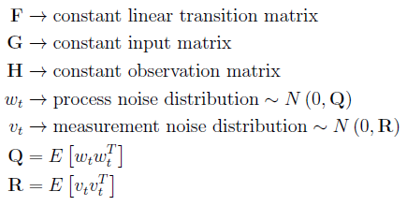
Kalman Filter
Rudolph E. Kalman (1960)
Assumes linear Gaussian systems
Equations of the state-space model are reconstructed as -
(6) - Process
(7) - Measurement
Gaussian distribution is closed under linear transformation, thus the transition density and the likelihood, i.e the integrations in the equations (4) and (5), are Gaussian distributions.
Therefore, sequentially the posterior density will be Gaussian.
Notes:
prior density p(x_{t}|y_{0:t-1}), likelihood p(y_{t}|x_{t}) and evidence p (y_{t}|y_{0:t-1})

Slide 14





Kalman Filter
The general framework of the Kalman Filter involves two main steps Time update or “Predict” and Measurement update or “Correct”.
Time Update:
Priori state estimate
Priori error covariance estimate
Measurement Update:
Kalman Gain
Posteriori state estimate
Posteriori error covariance estimate
Notes:
prior density p(x_{t}|y_{0:t-1}), likelihood p(y_{t}|x_{t}) and evidence p (y_{t}|y_{0:t-1})

Slide 15



Particle Filter
Real world systems are rarely linear and Gaussian.
Thus, for estimating more generalized processes, we use Monte Carlo methods.
The Monte Carlo Principle: If we take enough samples or particles to get a representative sample of the problem and run the particles through the system model then the transformed points can be used to compute the results we require.
Here each particle represents a possible state of the process and the next state is estimated by performing weighted statistical analysis of the particles.
Another advantage of Monte Carlo methods is that integration of any function or curve is trivial.
(8)
Notes:
{x¹, x², … , x^{N}} are N random samples taken from the target probability density p(x).

Slide 16
Particle Filter
Generic Particle Filter Framework:
Generate random particles - A large number of particles and their corresponding weights are generated. Initially all weights can be considered equal. The sum of all weights should be 1 so as to maintain total probability as 1.
Predict - Predict the next state of the particles based on the internal system model.
Update - Update the particle weights based on actual measurements. Particles closer to the actual measurements are weighted higher than the particles otherwise.
Resample - To avoid degeneracy in the algorithm we have to discard the particles with very low likelihood, given by their weights, and replace them with more probable particles.
Estimate - Compute the weighted average of all the particles to get an estimate of the system state.

Slide 17
Particle Filter
Sequential Importance Sampling (SIS):
The Particle Filter is a Sequential Monte Carlo Sampling method, where the Monte Carlo Sampling methods are applied iteratively at each step for estimating sequential states of an arbitrary system.
One of the most widely used Particle Filters is the Sequential Importance Sampling (SIS), in which the important region of the posterior distribution is approximated recursively.
Since the target density p(x) for most real processes is very difficult to sample, in Importance Sampling we choose a proposal density q (x) such that q (x) is positive for all x where p (x) is positive.
But in most real world problems the normalizing factor of p (x) is not known. Thus to ensure that the sum of all the weights is 1, the weights are normalized.
The normalised equations are given on the next slide.
Notes:
Importance sampling is applying weights to the particles based upon their closeness to the actual value.

Slide 18
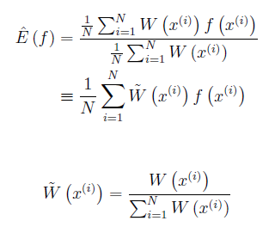

Particle Filter
Sequential Importance Sampling (SIS):
(9) - Estimate by Importance Sampling
(10) - Importance Weights
(11) - Normalized Importance Weights

Slide 19
Particle Filter
Degeneracy: The SIS method faces a major drawback called Weight Degeneracy problem.
The unconditional covariance of the importance (weight) distribution increases with time.
Thus over time, the number of non-zero weights reduces to such an extent that very few or even just one of the weights in W(x^{(i)}) remains positive.
This leads to wastage of computation time in calculating the trivial unimportant particle weights all the time.
Sampling Importance Resampling (SIR): The intuitive idea for solving the weight degeneracy problem is to eliminate the samples with small weights and duplicate the samples with larger weights. Usually resampling is inserted between two importance sampling steps, and this method is called as Sampling Importance Resampling (SIR)
There are many resampling methods available including Multinomial resampling [32], Systematic resampling and Residual resampling.
Notes:
Importance sampling is applying weights to the particles based upon their closeness to the actual value.

Slide 20
Experimental Setup
Apparatus:
2 Smartphones with BLE support - one transmitter and one receiver
nRF Connect for Android/iOS by Nordic Semiconductor
Process followed:
Configure the transmitter (beacon).
Start scanning for nearby transmitters on the receiver.
Collect enough RSSI values at fixed position.
Export collected values to CSV.
Use CSV file in ipython notebook as input.
Run Kalman filter and Particle filter and analyse results
Notes:
The nRF Connect app enable us to export the received RSSI values as a CSV (.csv) file.

Slide 21
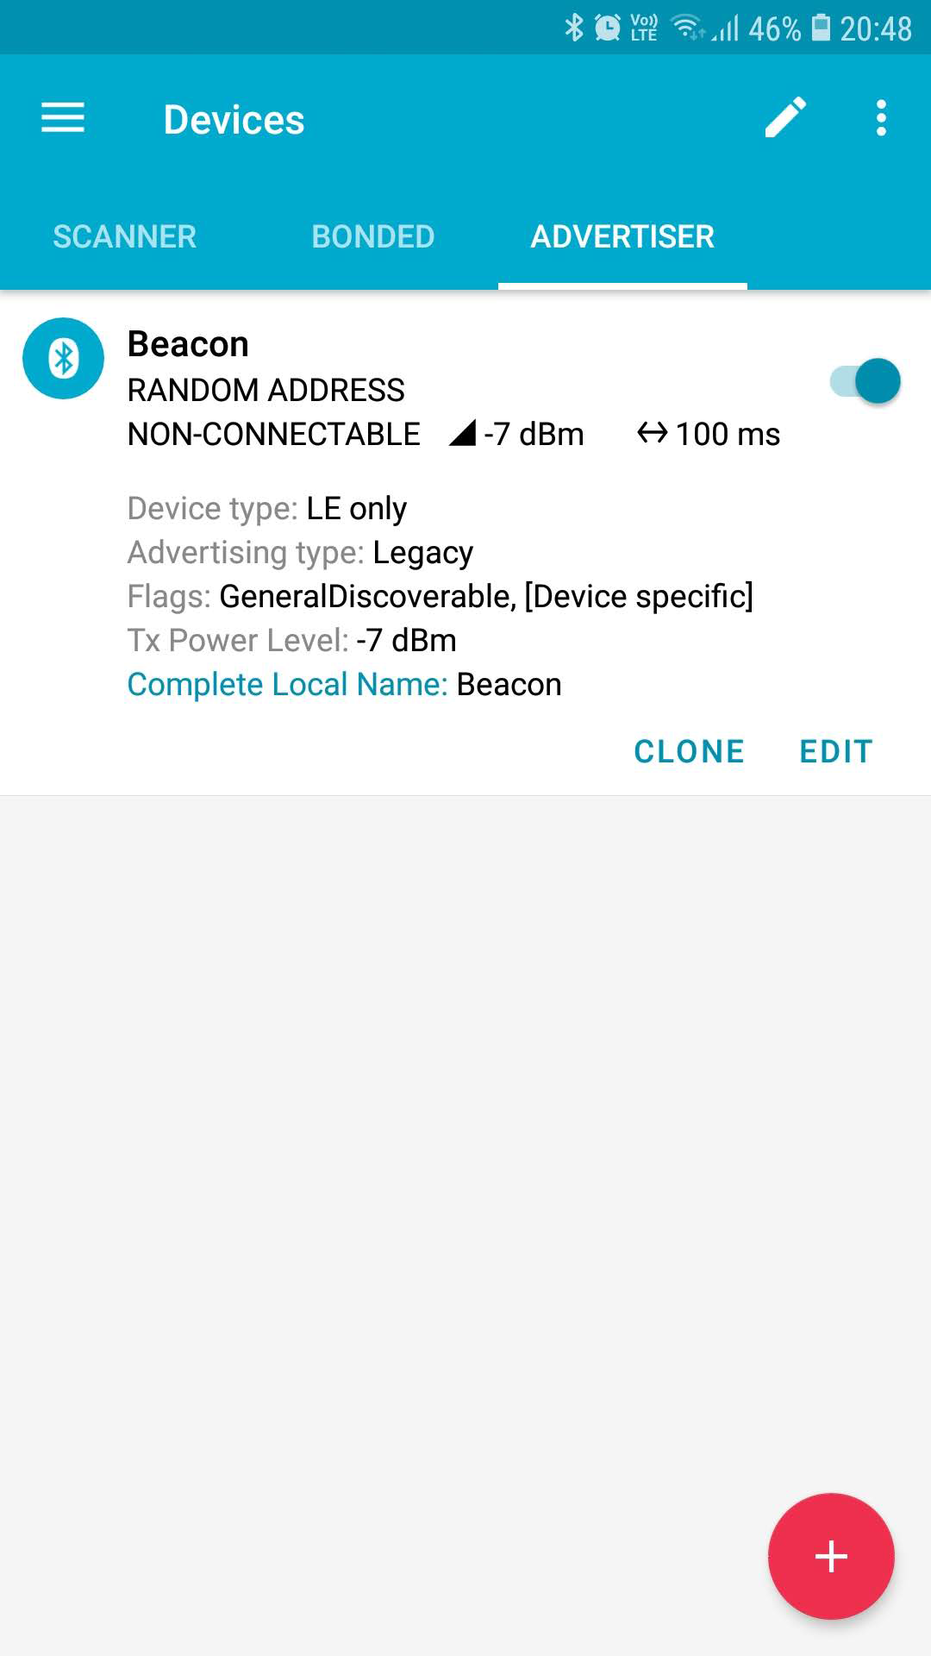
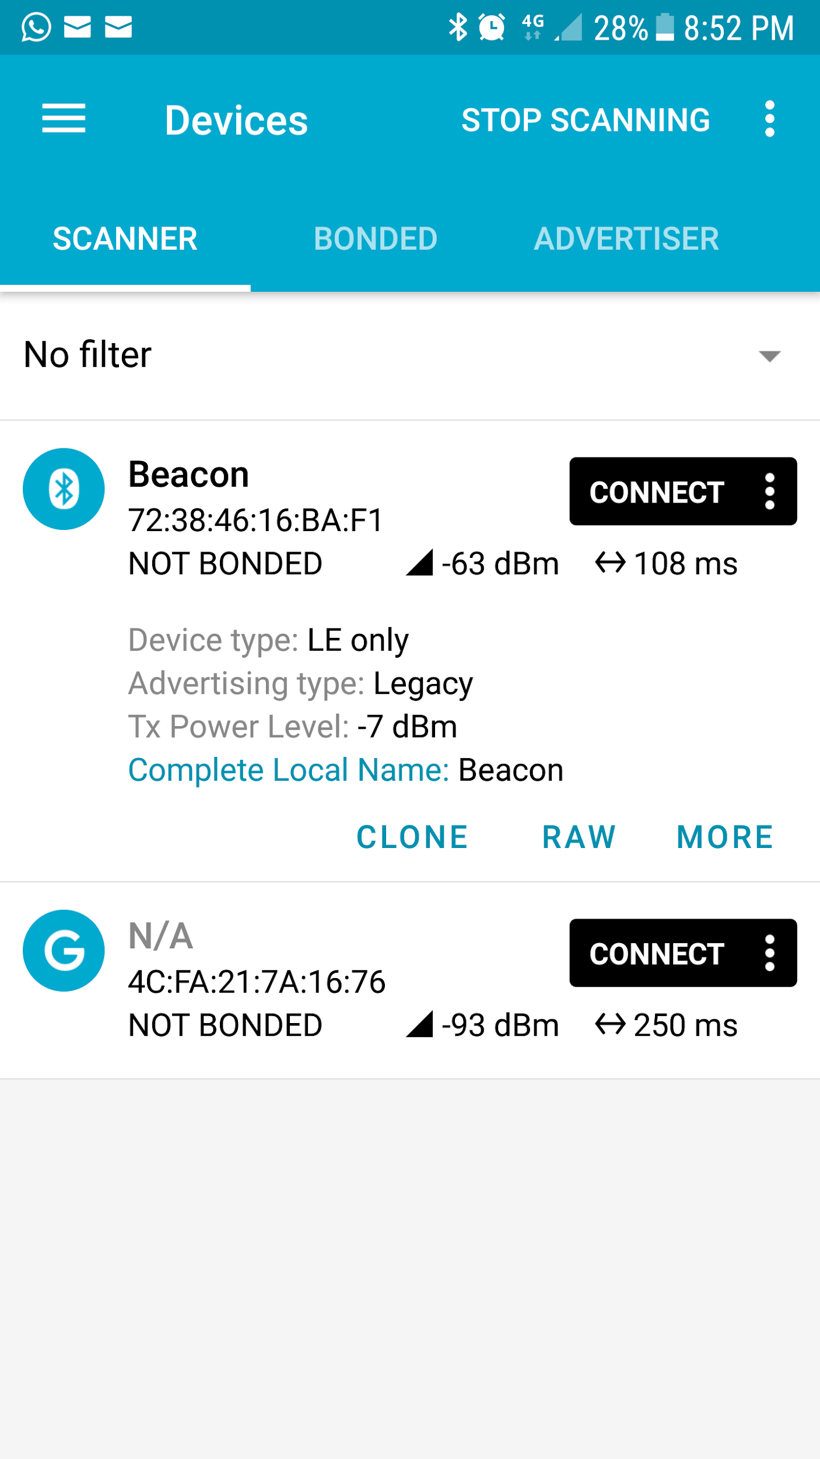
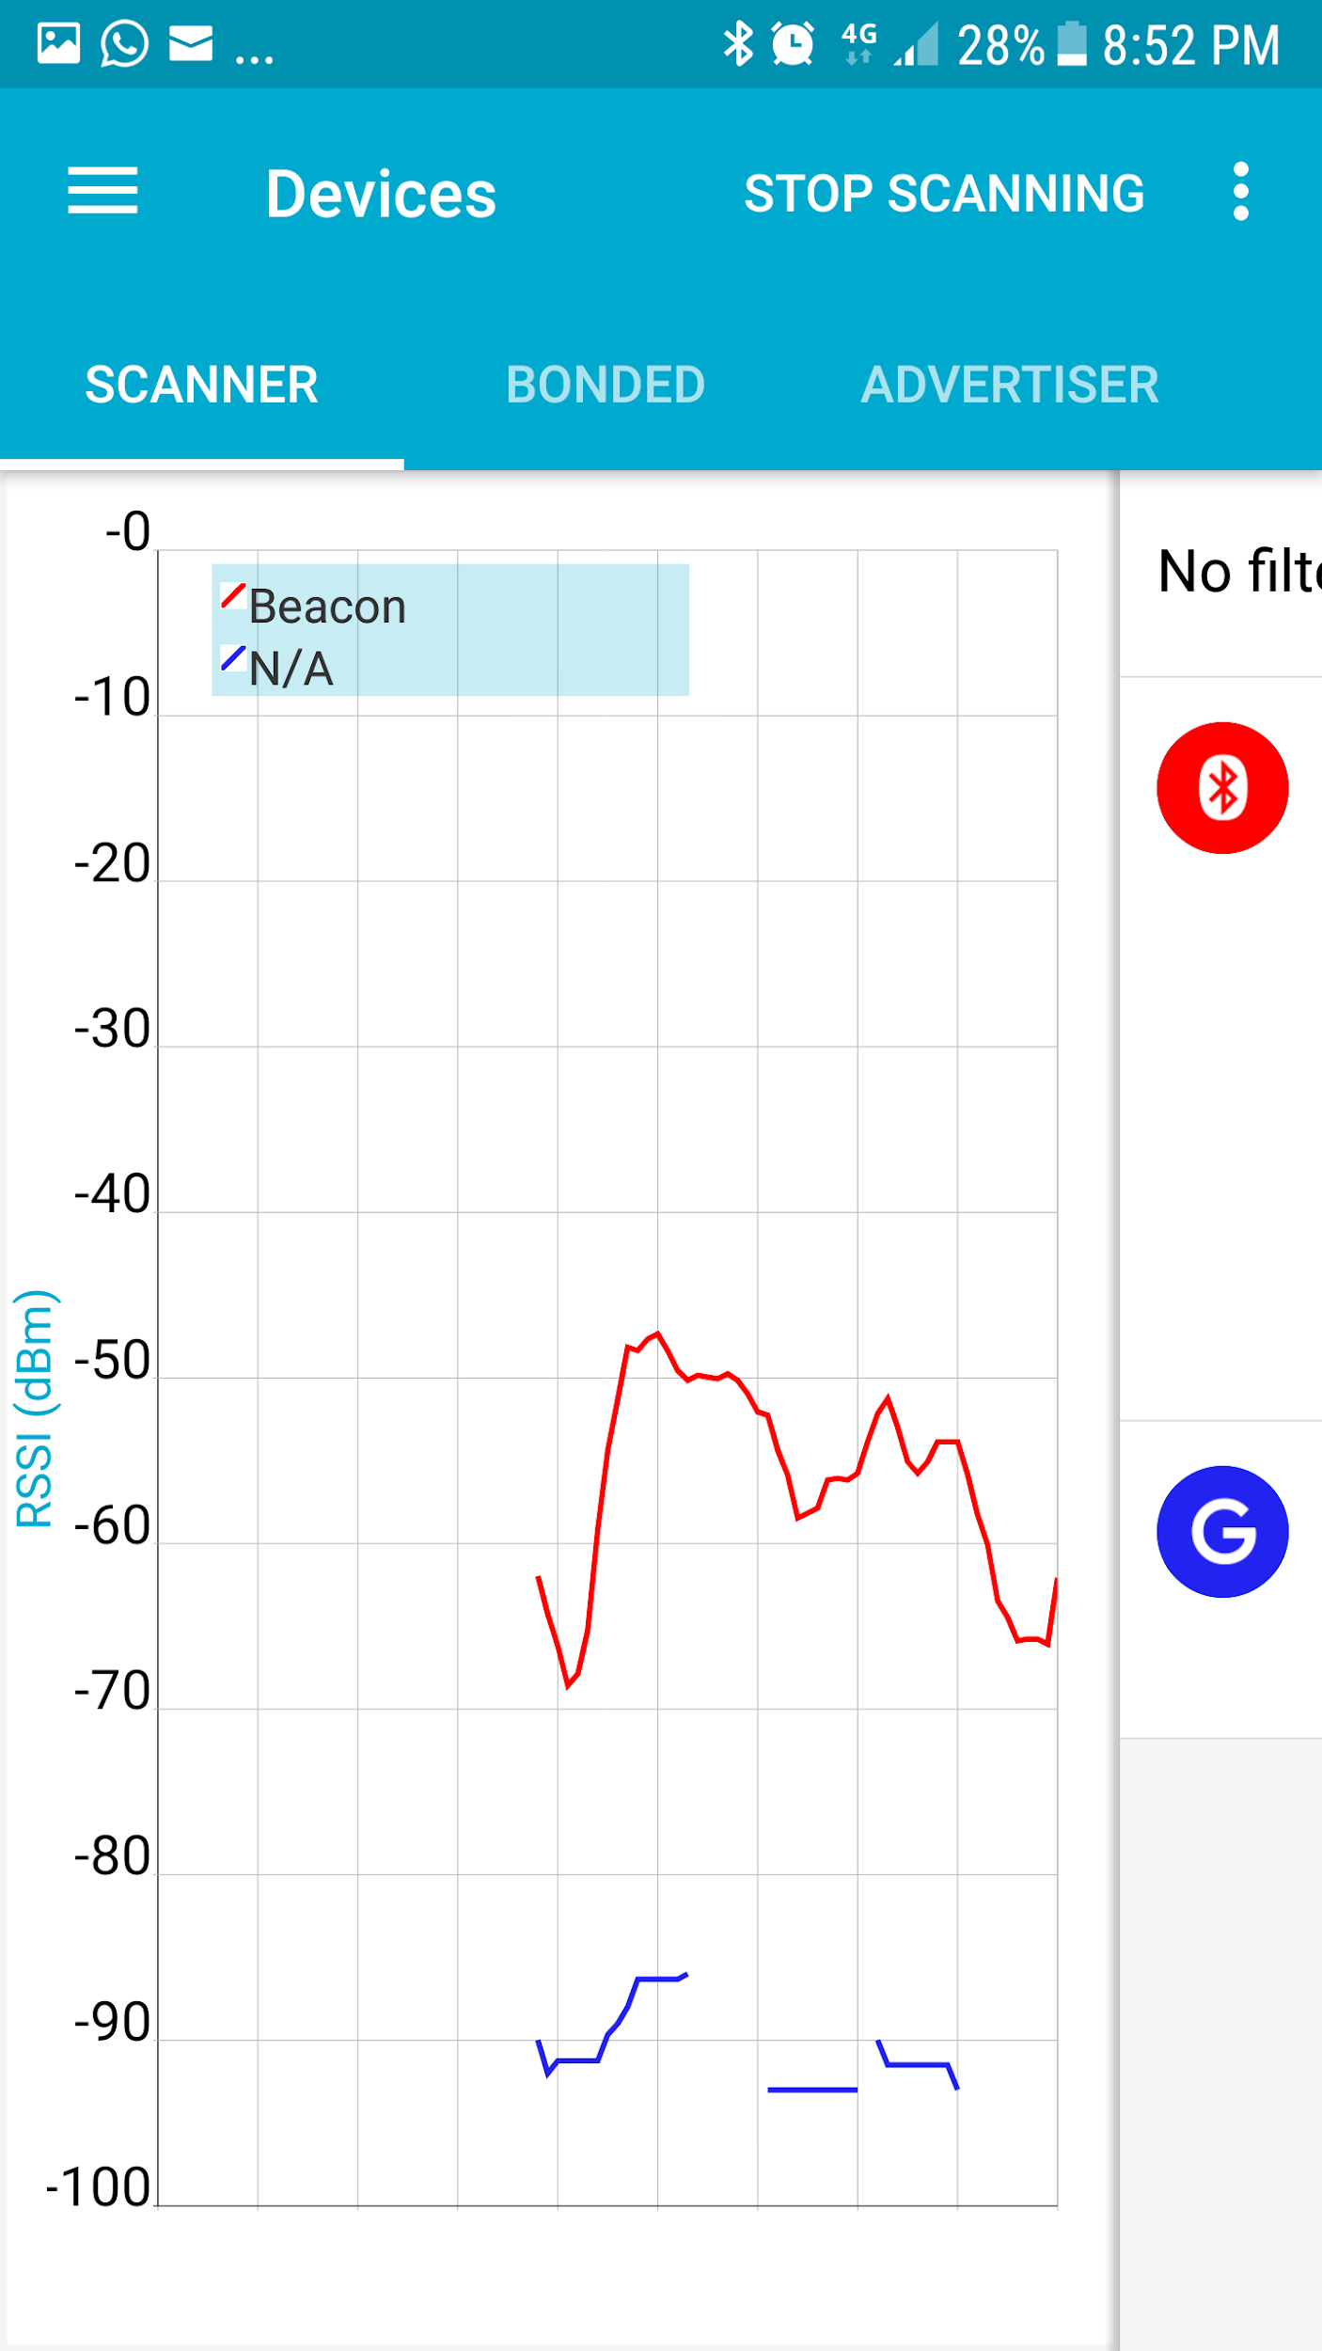
Beacon config
Scan for beacons
RSSI values collected

Slide 22
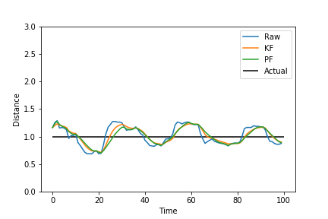
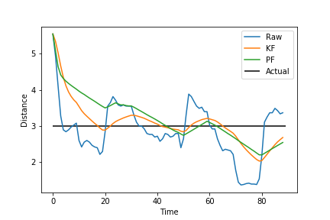
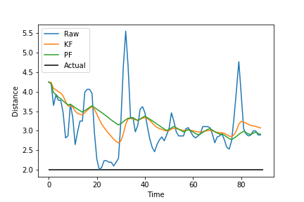
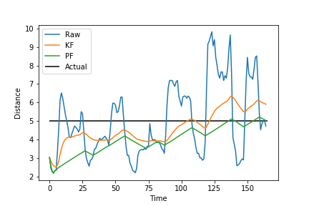
Results
@ 1m
@ 3m
Estimated Distances
(in m)
@ 2m
@ 5m
Notes:
The nRF Connect app enable us to export the received RSSI values as a CSV (.csv) file.

Slide 23
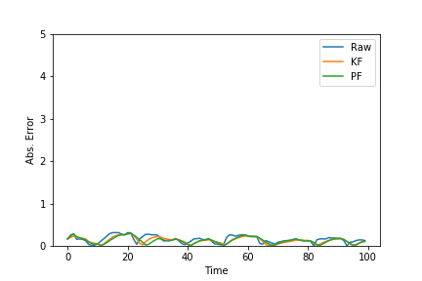
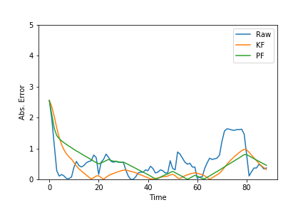
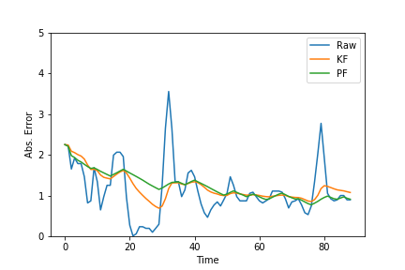
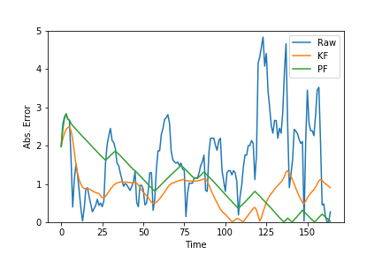
Results
@ 1m
@ 3m
Absolute
Errors
(in m)
@ 2m
@ 5m
Notes:
The nRF Connect app enable us to export the received RSSI values as a CSV (.csv) file.

Slide 24
Results
Distance | Raw | KF | PF
1m | 15.438181 | 12.795331 | 12.523117
2m | 98.538015 | 106.340627 | 108.032107
3m | 50.410696 | 33.877184 | 20.387668
5m | 272.282308 | 138.982297 | 171.505088
Distance | Raw | KF | PF
1m | 0.175286 | 0.147270 | 0.147053
2m | 1.291172 | 1.259012 | 1.274565
3m | 0.764925 | 0.629269 | 0.678469
5m | 1.936142 | 0.974871 | 1.266580
Total Error (in m)
Standard Deviation
or RMS Error
(in m)
Notes:
The nRF Connect app enable us to export the received RSSI values as a CSV (.csv) file.

Slide 25
Conclusion
The results of the experiment showed that post filtering, the readings become much more reliable and can be used for real-time distance estimation in localization.
Both the algorithms produced strikingly similar results in terms of error correction and noise reduction.
KF follows the curve closer than PF which often helps in reaching the actual value faster, thus reducing the time of error, whereas PF showed better noise reduction characteristics, thus flattening the noisy curve.
KF showed much better performance than PF in terms of computational efficiency.

Slide 26
References
Andrew Mackey, Petros Spachos, and Konstantinos N Plataniotis. Enhanced indoor navigation system with beacons and kalman filters. In 2018 IEEE Global Conference on Signal and Information Processing (GlobalSIP), pages 947{950. IEEE, 2018.
MW Khan, N Salman, A Ali, AM Khan, and AH Kemp. A comparative study of target tracking with kalman lter, extended kalman lter and particle lter using received signal strength measurements. In 2015 International Conference on Emerging Technologies (ICET), pages 1-6. IEEE, 2015.
Mathias Pelka and Horst Hellbruck. Introduction, discussion and evaluation of recursive bayesian filters for linear and nonlinear filtering problems in indoor localization. In 2016 International Conference on Indoor Positioning and Indoor Navigation (IPIN), pages 1-8. IEEE, 2016.
Janja Svecko, Marko Malajner, and Dusan Gleich. Distance estimation using rssi and particle filter. ISA transactions, 55:275-285, 2015.
Thorsten Nowak, Markus Hartmann, and Jorn Thielecke. Simultaneous position and channel parameter estimation applying adaptive kalman filters. In 2018 11th German Microwave Conference (GeMiC), pages 115-118. IEEE, 2018.

Slide 27
References
Kaibi Zhang, Yangchuan Zhang, and Subo Wan. Research of rssi indoor ranging algorithm based on gaussian-kalman linear filtering. In 2016 IEEE Advanced Information Management, Communicates, Electronic and Automation Control Conference (IMCEC), pages 1628-1632. IEEE, 2016.
Faheem Zafari, Ioannis Papapanagiotou, Michael Devetsikiotis, and Thomas Hacker. An ibeacon based proximity and indoor localization system. arXiv preprint arXiv:1703.07876, 2017.
Faheem Zafari, Ioannis Papapanagiotou, and Thomas J Hacker. A novel bayesian filtering based algorithm for rssi-based indoor localization. In 2018 IEEE International Conference on Communications (ICC), pages 1-7. IEEE, 2018.

